Slide 1
AWS PROJECT NEEMEIIT COMPANY
Presenting To : Pooja Neemkar Mam Group – “6”
TeamLead:Sowmya
Presenter:sharmila

Slide 2
Project Goals
What is meant by Ec2 Instances ?
How to create Ec2 Instances in AWS ?
What is meant by Relational Database ?
How to Create Relational Database in AWS ?

Slide 3
What is meant by Ec2 Instances?
EC2 instances stand for Amazon Elastic Compute Cloud instances.
They are virtual servers that you can rent on demand from Amazon Web Services (AWS).
Here are some of the benefits of using EC2 instances :
scalable, reliable, and secure
this are best way to run your applications, then EC2 instances are a good option

Slide 4
How to Create Ec2 Instances ?
There are some following steps to Create the Instance –
Go to "EC2" Instances of the AWS Management Console.
Click on the "Launch Instance" button.
Select an Amazon Machine Image (AMI).
Choose an instance type.
Number of instances, Purchasing option, Network, Security groups you have to configure this all while you are creating an Instance.
Configure security groups and Review the Instance.

Slide 5
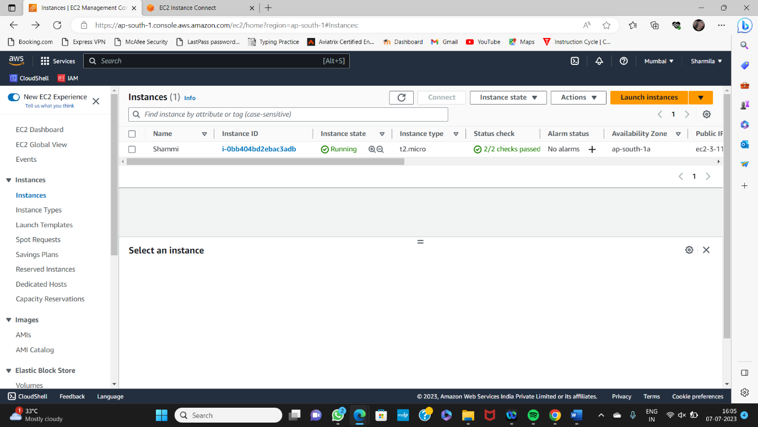
Ec2 Instance
-for more info…List location or contact for specification (or other related documents)

Slide 6
What is meant by Relational Database?
Amazon Relational Database Service (RDS) is a managed service that provides relational databases in the cloud.
RDS supports a variety of database engines, including MySQL, PostgreSQL, Oracle, and SQL Server.
Relational databases are a popular choice for storing data in the cloud because they are:
Scalable,Reliable,Secure and Cost-effective.
If you are looking for a way to store data in the cloud, a relational database in AWS is a good option.

Slide 7
How to Create Relational Database in AWS?
There are some following steps to Create Relational Database –
Go to the AWS Management Console and Search (RDS) Amazon Relational Database Service" service.
Click on the "Create Database" button.
Select the database engine that you want to use. For this example, we will use MySQL.

Slide 8
Relational Database:
Select the instance type and the storage capacity for your database.
Choose the Availability Zone where you want to create your database.
Click on the "Create Database" button
-for more info…List location or contact for specification (or other related documents)

Slide 9
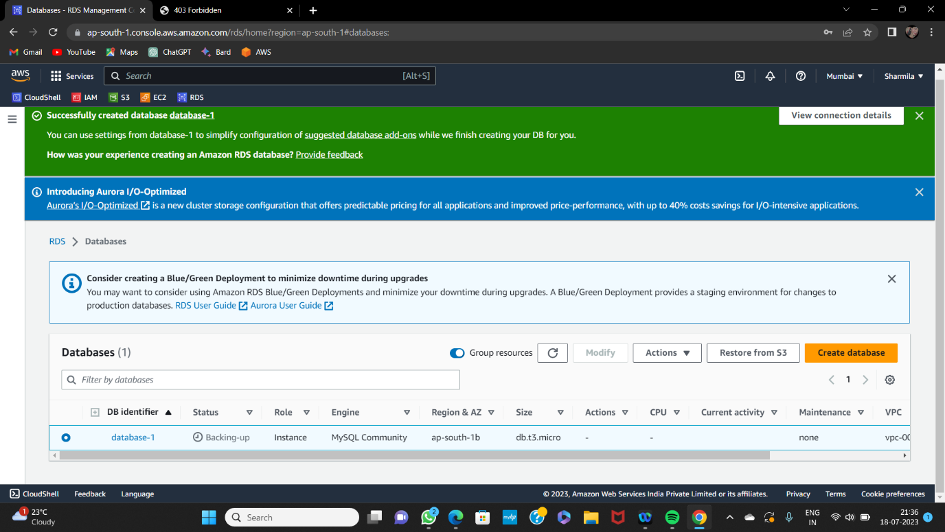
RDS

Slide 10
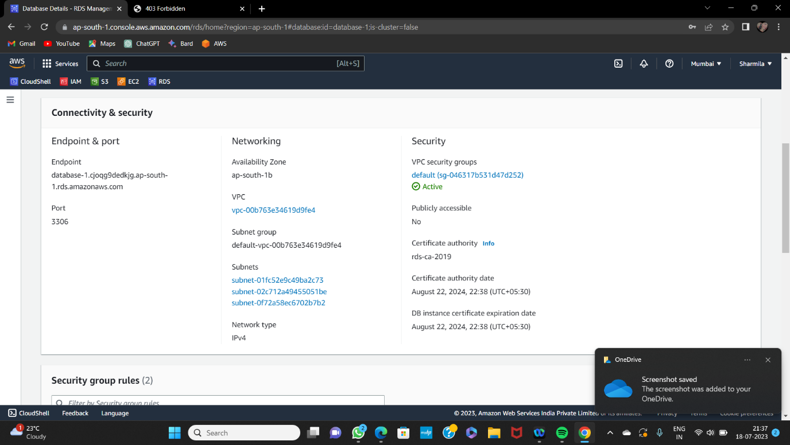

Slide 11
THANK YOU

